Slide 1






Workflow Automation
in Seismic Data Processing
and Integration with WOVOdat
Christina Widiwijayanti¹, Benoit Taisne^{1,2}, Nang Thin Zar Win¹,
Tania Espinosa-Ortega¹, Andika Bayu Aji ³, Darren Tan², Yizhou Luo ^{1,2}, Julie De Groote ^{1,2}
– in collaboration with WOVO observatories –
¹Earth Observatory of Singapore, Nanyang Technological University, Singapore
²Asian School of the Environment, Nanyang Technological University, Singapore
³Geological Agency, Bandung, Indonesia

Slide 2
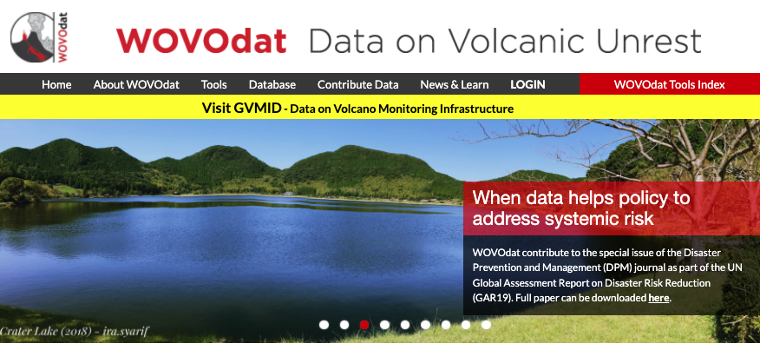











wovodat.org
WOVOdat – An online, growing library of worldwide volcanic unrest – develop by the World Organization of Volcano Observatories (WOVO) – IAVCEI, hosted by the Earth Observatory of Singapore.
The WOVOdat platform – provides unrestricted access to global volcano monitoring data – serving as a resource for comparing unrest both within the same volcano and between analog volcanoes. Its goal is to enhance understanding of eruptive processes, improve eruption forecasts, and support hazard assessment and mitigation efforts.
Partners & data contributors:

Slide 3
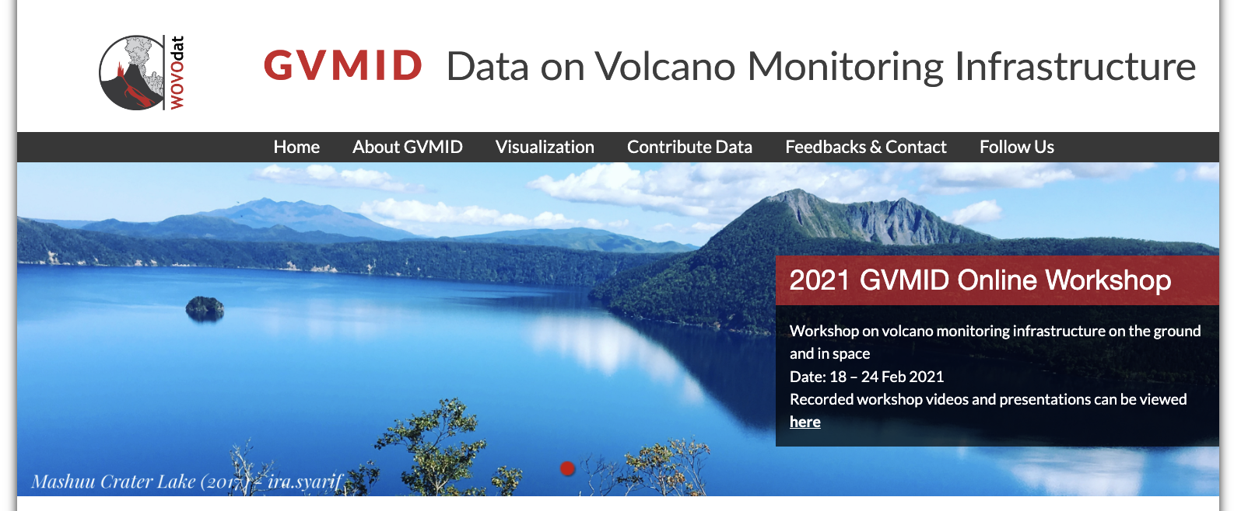



wovodat.org/gvmid
The Global Volcano Monitoring Infrastructure Database (GVMID) aims to document and enhance volcano monitoring capabilities from ground and space as integral part of WOVOdat.
GVMID offers insights into techniques and instrumentation at volcanoes, helping observatories improve monitoring networks and address gaps with remote sensing and new tools.
We're developing examples showing how GVMID enhances network design for better eruption anticipation and detection.
We invite global observatories and scientists to collaborate and contribute data, enriching the database and strengthening research, monitoring, and hazard mitigation.
Widiwijayanti et al. (2024),
Front. Earth Sci. 12:1284889.
doi: 10.3389/feart.2024.1284889
Espinosa-Ortega & Taisne (2024),
JVGR 452:108138
https://doi.org/10.1016/j.jvolgeores.2024.108138

Slide 4
Challenges in forecasting eruption
Forecasting volcanic eruptions is difficult because volcanic systems are inherently complex, non-linear, and unpredictable, creating significant uncertainty in interpreting monitoring data.
Key challenges include:
Non-linear volcanic processes: Magma ascent involves interacting physical and chemical changes that produce abrupt, hard-to-interpret behavior.
Limited and variable data: Many volcanoes lack long monitoring records; eruptions are infrequent; and data are often noisy, incomplete, or affected by instrument limitations.
Ambiguous precursors: Similar seismic, deformation, or gas signals may precede an eruption—or fade without one. Patterns vary between volcanoes and even between eruptions.
Interaction with external processes: Weather, hydrological conditions, tectonic events, and surface processes can obscure, modify, or mimic volcanic signals, complicating interpretation.
Model uncertainty: Balancing simple vs. complex models, quantifying uncertainty, and integrating diverse datasets remain major challenges.
In essence: Monitoring data provide essential clues, but eruption forecasting remains uncertain due to the complexity of volcanic systems, limited data, and the absence of universal precursory patterns—requiring a combination of data analysis, physical modeling, and expert judgment.

Slide 5



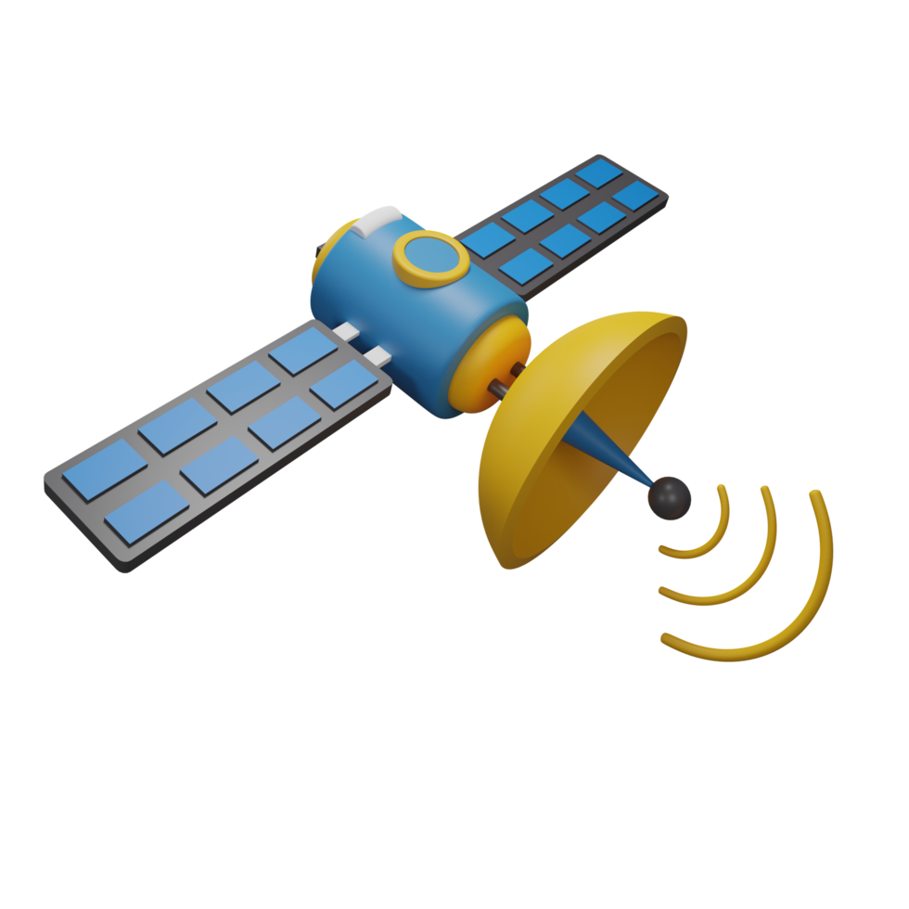



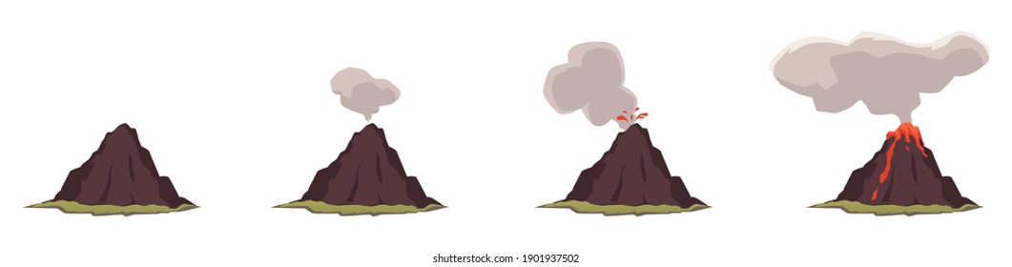
Workflow during crisis response: from data to decision
An integrated workflow: from data to decision
GLOBAL ERUPTION
CHRONOLOGY
DATABASE
VOLCANO
MONITORING
(OBSERVATORY)
GLOBAL VOLCANO MONITORING
DATABASE
(Not all unrest leads to eruption)
Real-time
data
Past
unrest
Past scenarios/
outcomes
Analysis of
monitoring data
Comparison or analogue analysis
FORECASTING
(PROBABILISTIC EVENT TREE ANALYSIS)
Scenario outcomes
Processed data
Precursory indicators
& patterns
Evidence-based
decisions
A dynamic workflow: adaptive to evolving volcanic conditions
MODELS, EXPERT ELICITATION
Evolving volcanic activity
Volcano alert level

Slide 6
Data strategy: integrate diverse data and contextualize
GLOBAL ERUPTION
CHRONOLOGY
DATABASE
VOLCANO
MONITORING
(OBSERVATORY)
GLOBAL VOLCANO MONITORING
DATABASE
Real-Time Monitoring Data
Multi-parameters: seismic, geodetic, gas, remote sensing
Data must be accurate, accessible, and timely
Standardised processing workflow, analysis ready
Historical Records as Context
Past eruptions guide interpretation of unrest
Analog comparisons: same volcano & global analogues
Enables scenario forecasting and improved communication
The Challenges
Diverse data sources: multi-parameter networks, fieldwork, labs, and models
Lack of consistency: no standardized workflows, fragmented formats, and discontinuous records
Crisis urgency: limited time and high data complexity hinder rapid analysis

Slide 7
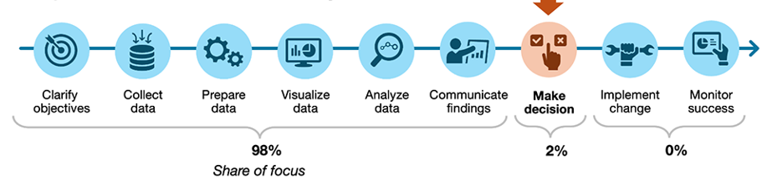
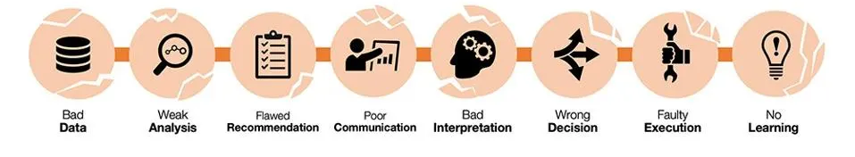
Decision making during volcanic crisis
The critical gap occurs when extensive data collection and analysis fail to inform timely, effective decisions.
This can lead to slow responses, misinterpreted insights, over-reliance on data, and missed opportunities—reflecting a disconnect between analysis and action.
Common imbalance
Most attention is given to pre-decision steps, while the actual decision-making receives insufficient focus, creating a critical gap.
8 potential failure points in decision process:
Effective Data Storytelling: How to Drive Change with Data, Narrative, and Visuals (Dykes , 2019)
Notes:
Effective Data Storytelling: How to Drive Change with Data, Narrative, and Visuals
By Brent Dykes
https://www.effectivedatastorytelling.com/
Sharing both explicit (documented) and implicit (experiential) knowledge is crucial for building robust crisis management strategies by fostering faster, more informed decisions and optimizing resource use. Explicit knowledge provides clear records of past events and procedures, while implicit knowledge, gained from experience, offers unique insights into nuanced problem-solving. Combining these knowledge types creates a learning organization that can better anticipate threats, develop effective plans, and adapt quickly during a crisis.
How Knowledge Sharing Strengthens Crisis Management
Informed Decision-Making:
Documented "lessons learned" from previous crises (explicit knowledge) give responders evidence-based insights. Experiential knowledge from seasoned individuals provides an intuitive understanding of how to navigate unforeseen challenges.
Faster Response Times:
Access to shared knowledge, both recorded and tacit, reduces the time needed to understand a situation and generate effective problem-solving plans.
Efficient Resource Allocation:
Knowing what worked (and what didn't) in past situations helps organizations use resources more effectively during a crisis, ensuring they are directed where they are most needed.
Enhanced Risk Prediction:
By sharing knowledge about potential threats, vulnerabilities, and past incidents, organizations can better predict future crises and take proactive steps to mitigate them.
Improved Planning & Practice:
Sharing explicit and implicit knowledge helps in creating realistic and actionable crisis management plans. The practice of sharing knowledge also strengthens the organization's ability to rehearse and execute these plans effectively when needed.
Organizational Learning:
The continuous sharing of knowledge promotes a culture of learning, where the organization can adapt and improve its responses over time, becoming more resilient.

Slide 8

Effective forecasting relies on integration and iteration—bringing together diverse datasets, applying probabilistic frameworks that openly acknowledge uncertainty, and continually refining models as new information emerges.
Ensuring data consistency, long-term legacy records, and standardized analysis-ready formats is essential for identifying meaningful trends, comparing behavior across eruptions, and improving the reliability of forecasting models.
https://www.sap.com/design-system/
Forecasting is not a one-time prediction but an adaptive, evidence-driven process that connects scientific understanding with hazard management.
When coupled with clear communication, this approach enables timely, effective, and well-informed decisions grounded in rigorous data analysis and assessment, ultimately strengthening the safety and resilience of at-risk communities.

Slide 9


WOVOdat Database Schema & Structure
Supporting data
VOLCANO
Contact
Bibliographic
Observation
Image, map, photos
Airplane/Satellite
Earthquake translation
System
etc.
MySQL relational database management system (RDBMS)
Background information
Inferred processes
Tectonic settings, rock type, morphology, etc.
Hydrothermal interaction
Magma movement
Magma pressure
Volatile saturation
Tectonic interaction
Eruption information
Eruption phases, recurrences, alert level, etc.
MONITORING
NETWORK
SATELLITE/AIRBORNE
SEISMIC
STATION
DEFORMATION
STATION
GAS
STATION
HYDROLOGY
STATION
FIELD
STATION
THERMAL
STATION
METEO
STATION
Instrument
Instrument
Instrument
Instrument
Instrument
Instrument
Instrument
DATA:
Event
Intensity
Tremor
Swarm
RSAM
SSAM
Waveform
DATA:
Angle
Tiltmeter
Strainmeter
EDM
GPS
Leveling
InSAR
DATA:
Sampled gas
Soil efflux
Plume
DATA:
Hydrologic
DATA:
Magnetic
Electric
Gravity
DATA:
Thermal (ground based & remote sensing)
DATA:
Meteo data
https://wovodat.org/doc/index.php
Almost all data: time stamped, geo-referenced, link to data owner, references/sources, data uploader, publish date.

Slide 10

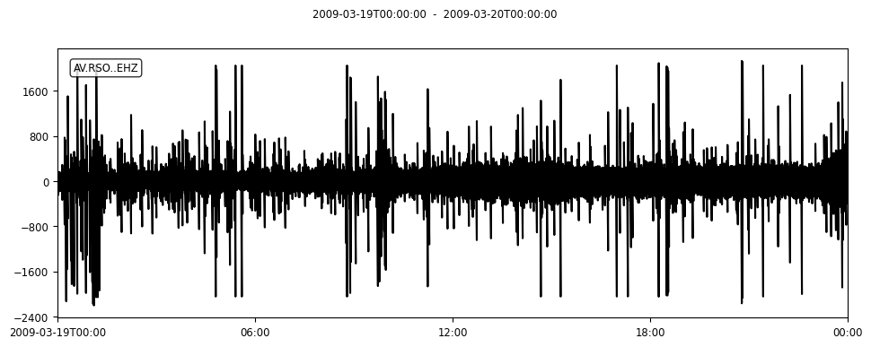

Seismic data processing workflow
Raw waveform
OBJECTIVES:
to develop automated techniques for optimizing warning times before volcanic impacts
to create a standardized model of volcano-seismic unrest, using global volcano seismic waveform data
to develop open-source tools and training programs
to contribute the outcomes to open repository WOVOdat.
Metadata (infrastructure)
DATA PREPARATION
Continuous waveform
PRECONDITIONED.mseed
Metadata (preprocessing)
Obtaining Continuous Waveform Data requiring preconditioning:
  Gaps => fixed number, interpolation, average, folding.
  Pre-filled gaps
  Sampling rate
  Overlaps
  Spikes/big numbers/calibration pulses
  Start-time and End-time not match the metadata
EARTHQUAKE DETECTION,
TREMOR CATALOG, ETC.
SEISMIC TIME SERIES
METRICS
(RSAM, SSAM, Seismic Intensity, etc.)
Detected events & time series (CSV file)
Archiving & managing the datasets:
  Preconditioned (waveform) data
  Metadata
  Processed data: detected events & features, RSAM, SSAM, RMS, Seismic intensity ratios, etc.
  Eruption/unrest phases
Metadata (processing)
FEATURES EXTRACTION
FEATURES EXTRACTION
Features (CSV file)
Metadata (processing)

Slide 11
1
Waveform data & metadata
What data to be archived?
Seismic monitoring metadata (FDSN standard)
“Network-Station-Channel” code: f"{net.code}.{sta.code}.{cha.code}”,
"Latitude": sta.latitude,
"Longitude": sta.longitude,
"Elevation": sta.elevation,
"Sitename": sta.site.name if sta.site else "",
"StartTime": cha.start_date,
"EndTime": cha.end_date,
"Sampling": cha.sample_rate,
"NumGaps": num_gaps,
"TotalGapLength_sec": total_gap_length,
"MaxGapLength_sec": max_gap_length,
"PercentAvailability": percent_availability,
"Distance_km": distance_km,
"Sensor": sensor_desc,
"DataLogger": logger_desc
Instrument response file
Preconditioning metadata
Preconditioning waveform (mseed)
Daily drum-plot (?)
Data availability, to correlate with any volcanic activity:
  Unrest: eruption, failed eruption, eruption phases (explosion, lava extrusion, etc.)
  Phenomena & processes (PDC, lahar, lava flow, dike propagation, intrusion, magma migration, degassing, ash venting, swarm, etc.)
Data preconditioning (obtaining continuous waveform data requiring preconditioning)
  Gaps (fixed number, interpolation, average, folding)
  Pre-filled gaps
  Sampling rate (use the lowest)
  Overlaps
  Spikes/big numbers/calibration pulses
  Start-time and End-time not match the metadata

Slide 12
2
Processed time series data & derived attributes
Types of processed seismic time-series data products
RSAM (Real-time Seismic-Amplitude Measurement) – A running average of seismic amplitude over time, used to track overall seismic energy and detect changes in volcanic activity trends.
SSAM (Seismic Spectral Amplitude Measurement) – Frequency-based amplitude analysis that highlights changes in dominant frequencies, useful for distinguishing tremor types or eruption precursors.
DSAR (Displacement Seismic Amplitude Ratio) – Ratio of amplitudes at different stations or components, often used to infer source depth or changes in source processes.
dV/V (Seismic Velocity Change) – Measures relative changes in seismic wave velocity, indicating stress, temperature, or crack-density variations within the volcanic edifice.
Others – Such as cumulative seismic energy release, spectral ratios, polarization analysis, or other derived metrics tailored to specific monitoring objectives.
Parameters to be standardized for seismic time-series processing
Data sampling rate – 5 minutes
Moving window & interval step – Define uniform window lengths and step sizes for calculations (e.g., RSAM, SSAM).
Frequency band ranges – Use standardized frequency bands for filtering and spectral analysis. [0.1-0.5]; [0.5-1]; [1-4]; [4-8]; [8-16] Hz
Filtering – Apply consistent filter types (e.g., band-pass, high-pass) and parameters.
Instrument response removal – Uniformly remove instrument responses to obtain comparable ground motion measurements.
What data to be archived?
  Processed time series data products & processing metadata
  Also attributes? similar as what being used by Dampsey et al., 2022 (700 types?)

Slide 13
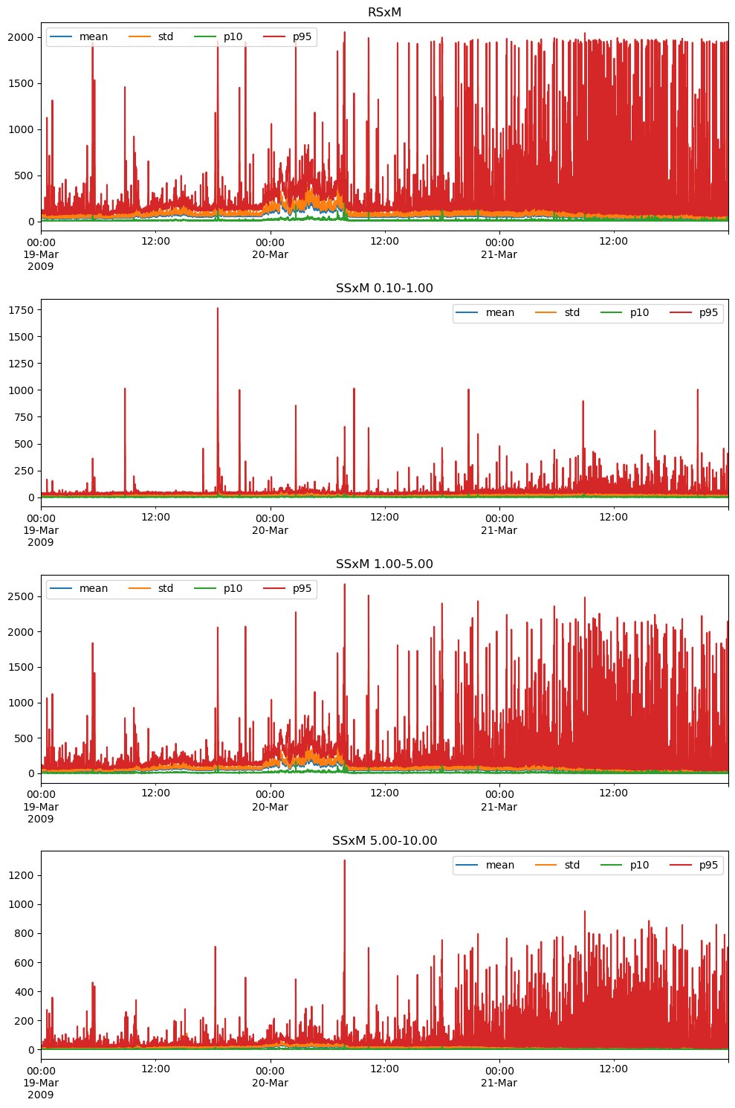
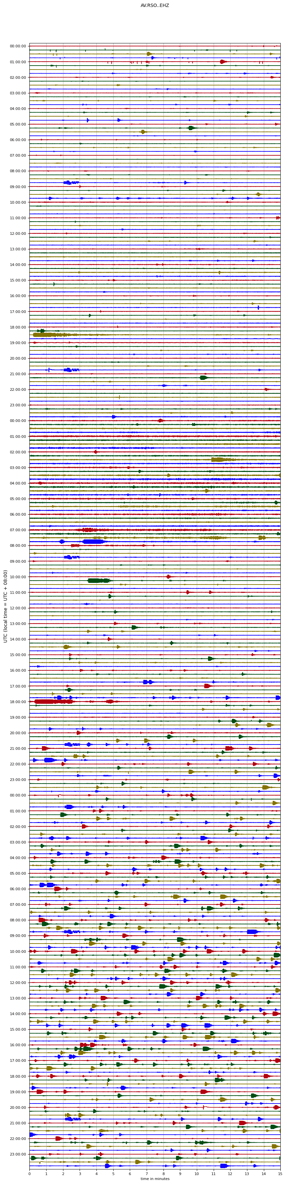
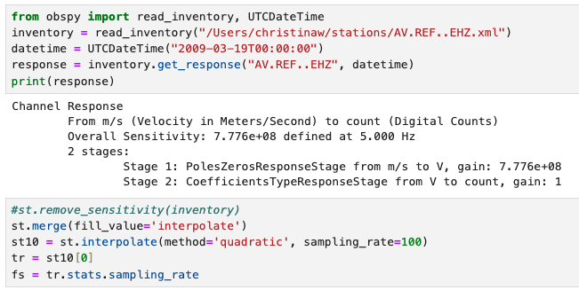
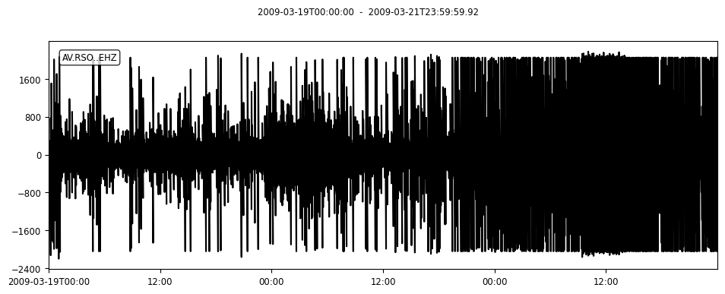
Redoubt(network “AV”, station “RSO”, component “EHZ”)
t1 = UTCDateTime("2009-03-19T00:00:00.0Z")
t2 = UTCDateTime("2009-03-22T00:00:00.0Z")
Remove instrument response

Slide 14
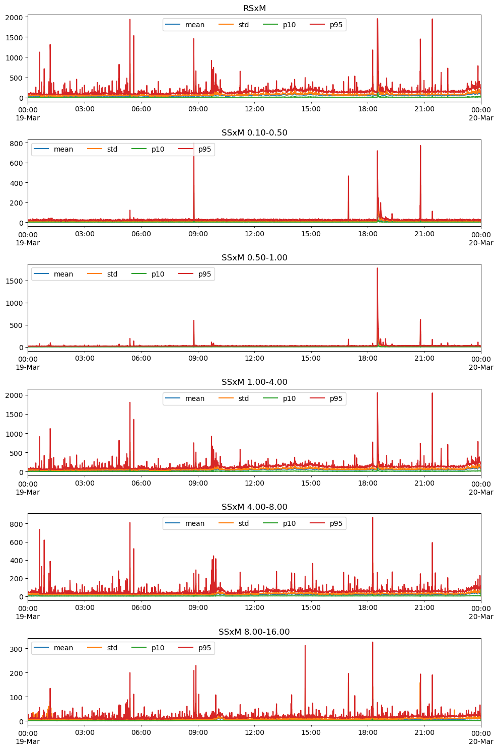
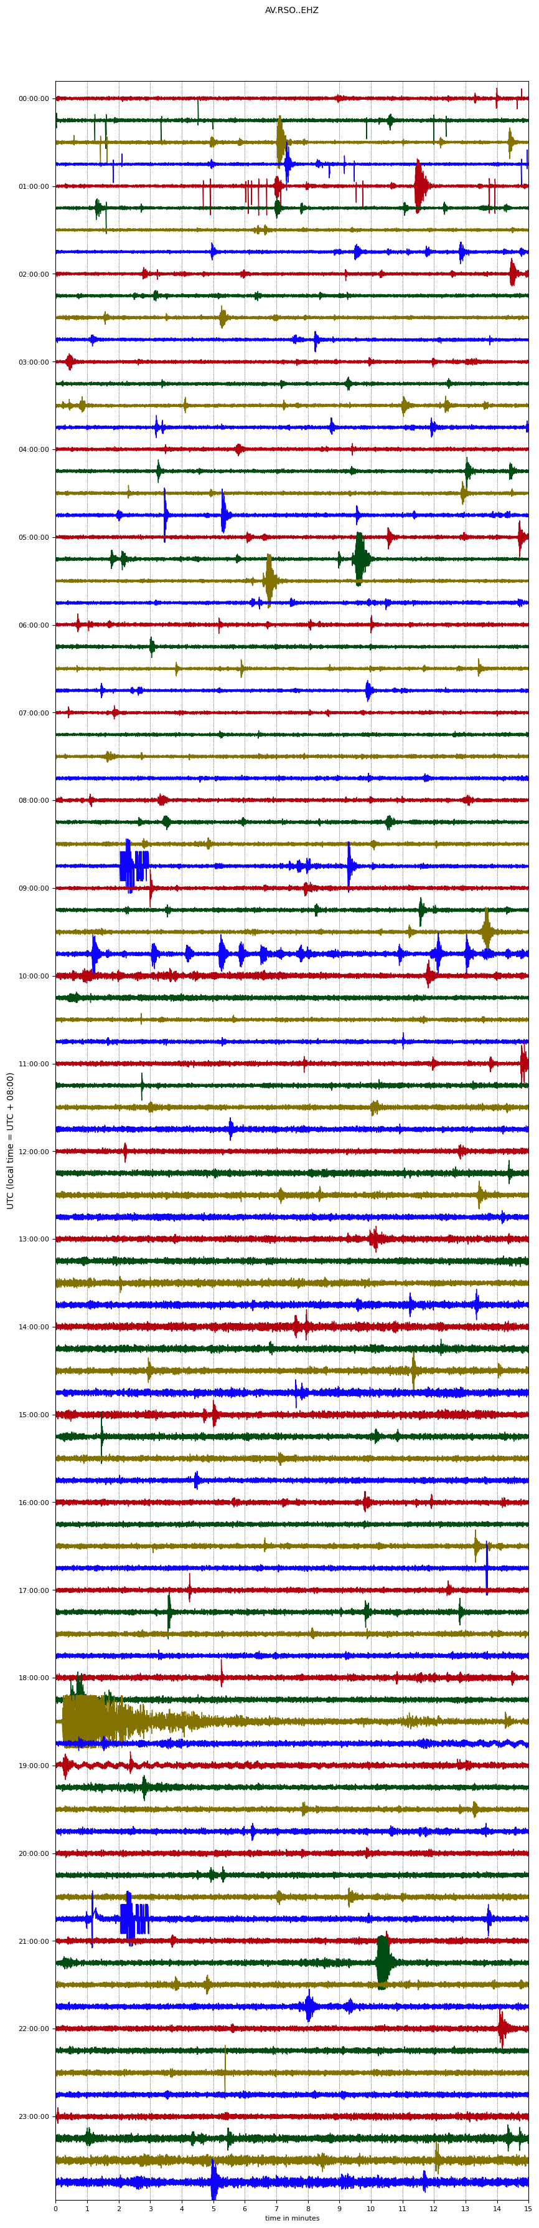
Redoubt RSO 19 Mar 2009

Slide 15
3
Earthquake detection & attributes
Detected events by different techniques (pre-existing & developed in house)
Processing metadata
Classification
Attributes
What data to be archived?
  Detected events, event trace (?), & processing metadata (algorithm/method used)
  Attributes

Slide 16
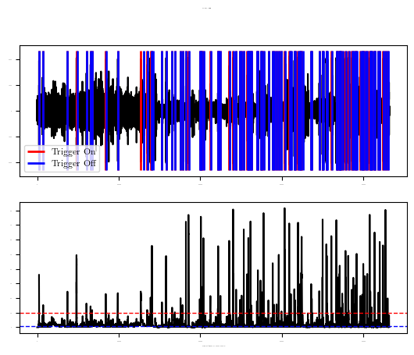
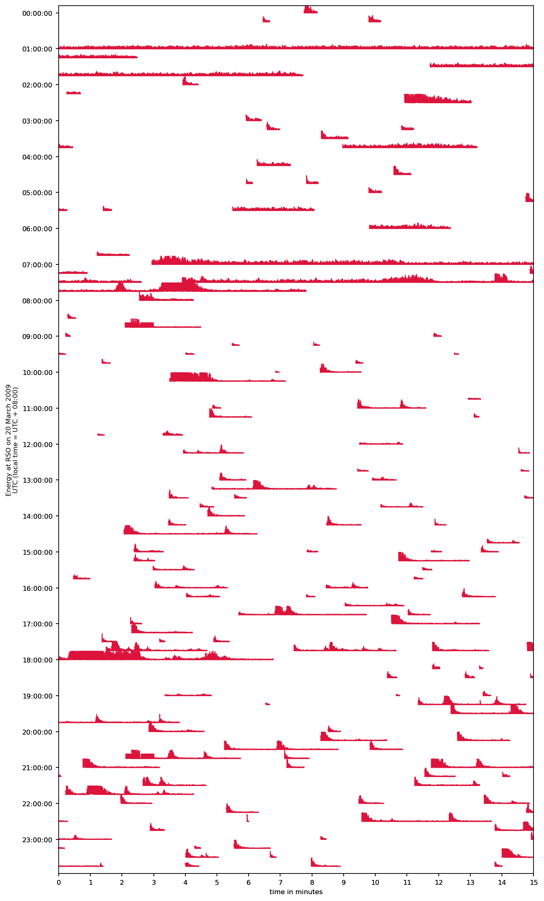
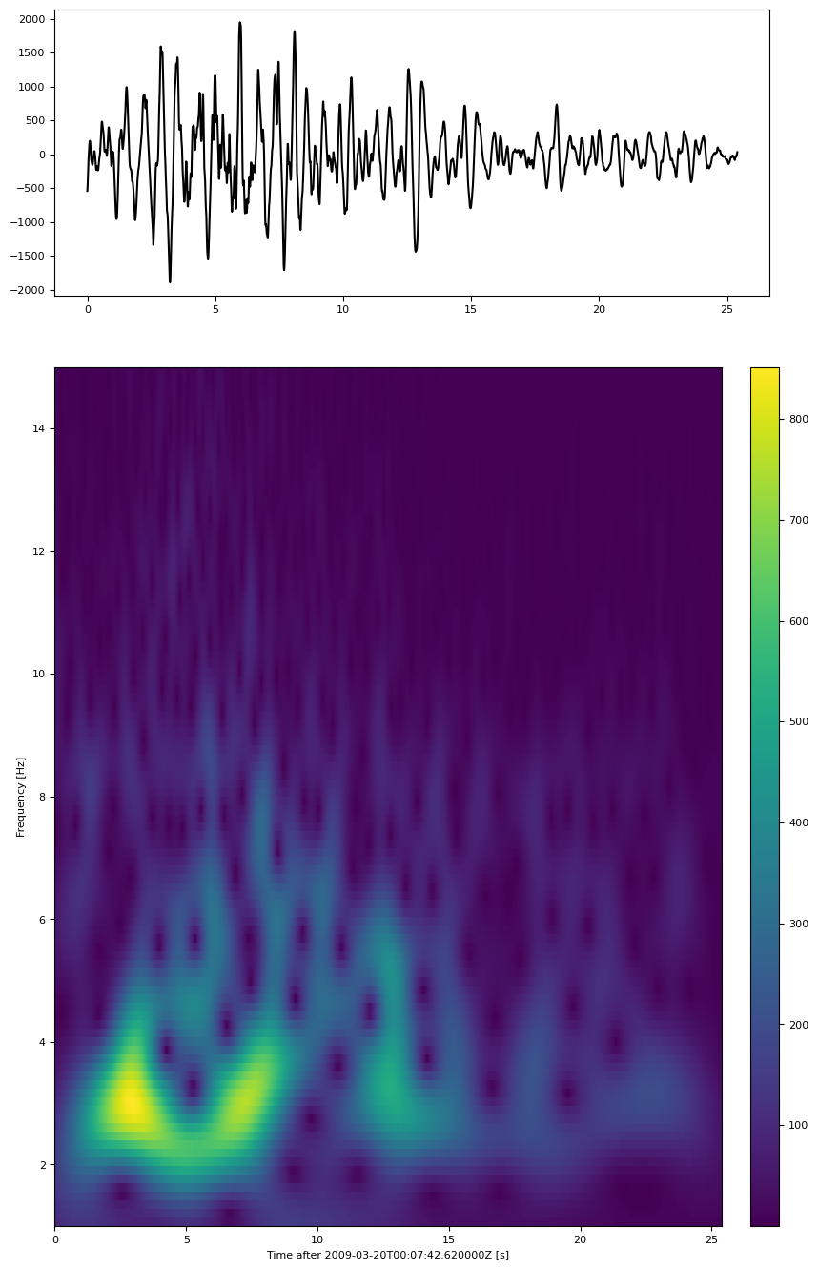
CASE EXAMPLES OF EARTHQUAKE DETECTION
Redoubt(network “AV”, station “RSO”, component “EHZ”)
t1 = sa.UTCDateTime("2009-03-20T00:00:00.0Z")
t2 = sa.UTCDateTime("2009-03-21T00:00:00.0Z")
Triggering (event detection)
Detected events
Event plot

Slide 17
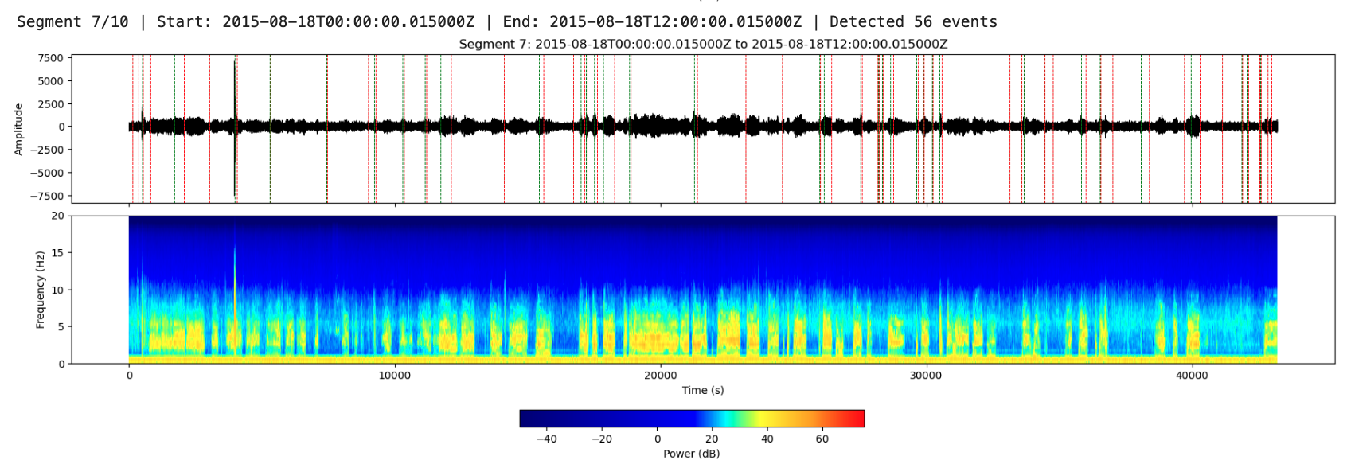
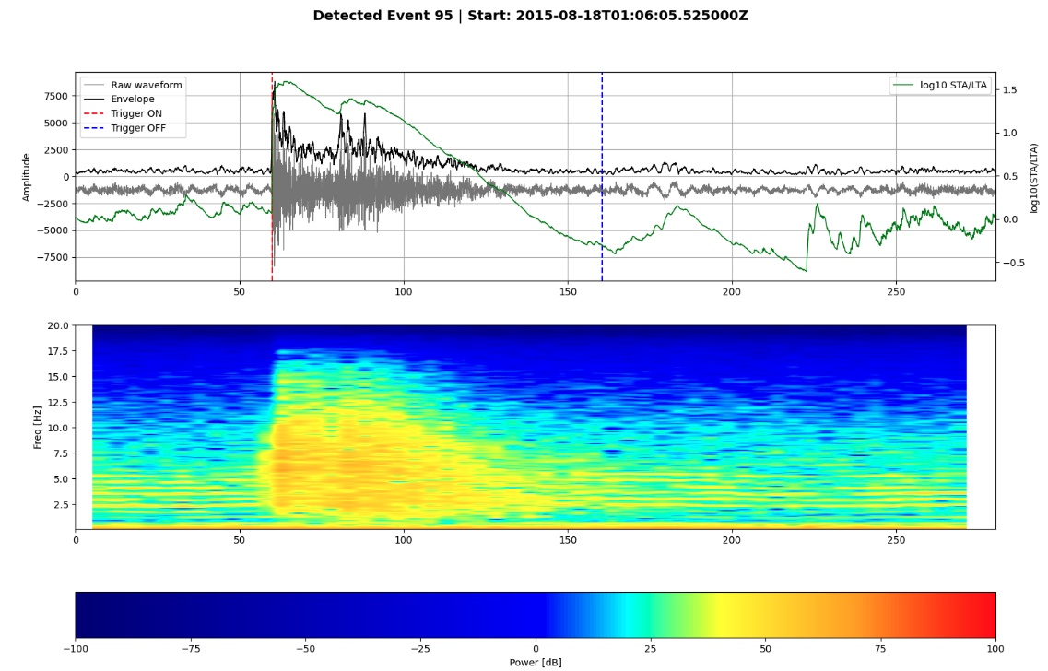
Improving Data Flow and Processing
  Streamlined data management pipelines
  Standardized protocols for interoperability
  Automation for rapid, consistent hazard assessment
Raw waveform
Real-time Seismic Amplitude Measurement (RSAM)
DATA PREPARATION
Continuous waveform
EARTHQUAKE DETECTION,
TREMOR CATALOG, ETC.
SEISMIC
TIME SERIES
METRICS
(RSAM, SSAM, etc.)
Earthquake detection
FEATURES EXTRACTION
FEATURES EXTRACTION
Database Integration:
Store standardized metrics, event catalogs, and associated metadata in WOVOdat

Slide 18


Global volcano monitoring databases: Driving a sustainable cycle
About GVMID Widiwijayanti et al., 2024
About NRFi project
Core Role
Bridge: connect past & present
Dual Function: archive & decision support
Knowledge Engine – reuse, analyse, forecast, collaborate
Value Creation
Cycle: self-improving system
Insight: sharper detection & forecasting
Impact: resilience, innovation, sustainability
WOVOdat
Web Service
Nang et al., 2025
WOVOdat:
1,477 monitored volcanoes
1,678 unrest episodes from 282 volcanoes

Slide 19
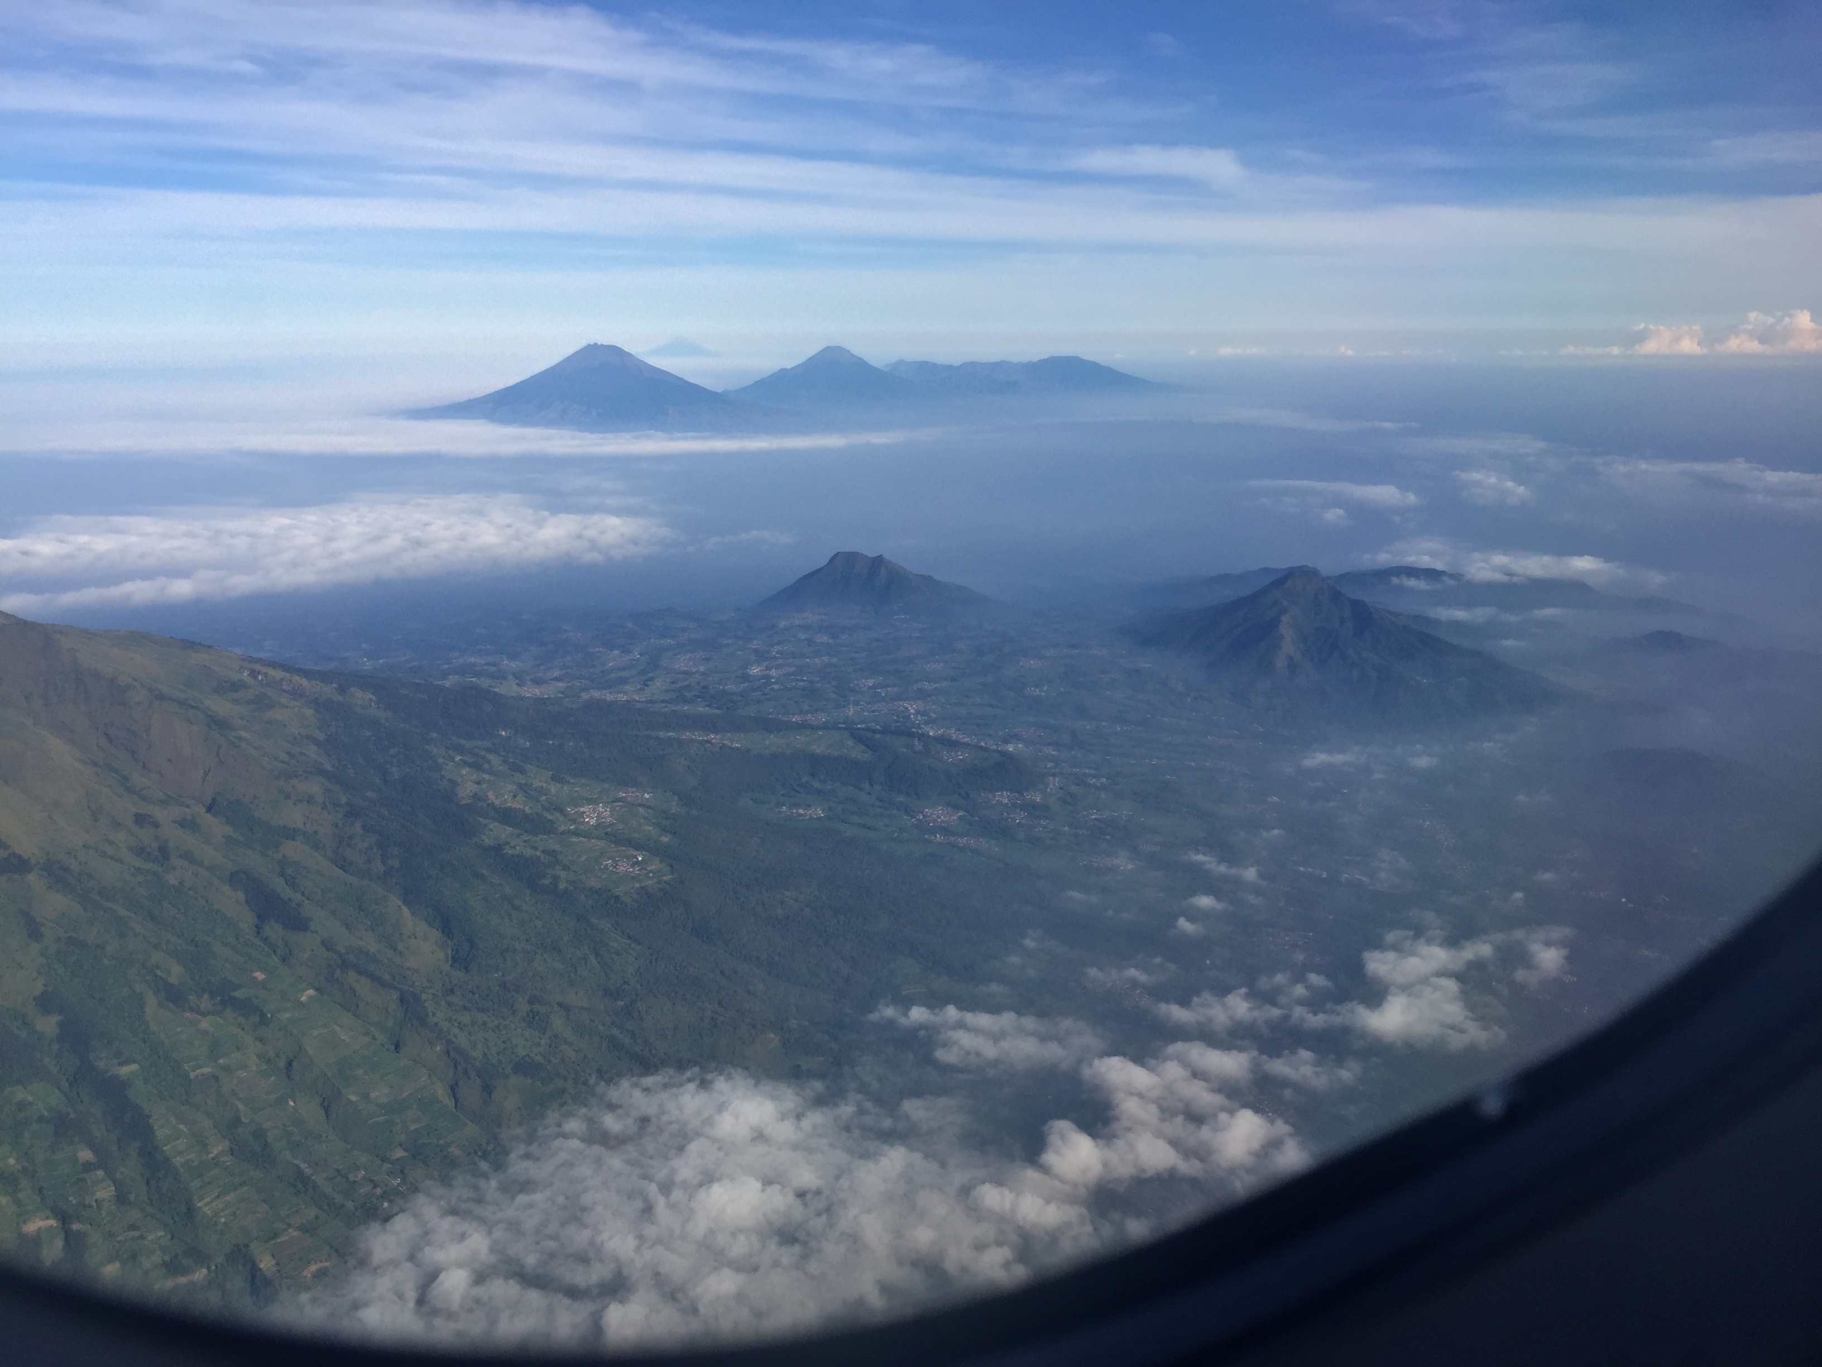
Open science and standardized data transform past records, models, and expert insights into faster, evidence-based volcanic crisis decisions.
  Thank you to all our partners and contributors!
  We look forward to your continued support and welcome new contributions!

